Slide 1


Data Mining and Data Warehousing CSE-4107
Md. Manowarul Islam
Associate Professor, Dept. of CSE
Jagannath University

Slide 2
Weather Data: Play or not Play?
Outlook | Temperature | Humidity | Windy | Play?
sunny | hot | high | false | No
sunny | hot | high | true | No
overcast | hot | high | false | Yes
rain | mild | high | false | Yes
rain | cool | normal | false | Yes
rain | cool | normal | true | No
overcast | cool | normal | true | Yes
sunny | mild | high | false | No
sunny | cool | normal | false | Yes
rain | mild | normal | false | Yes
sunny | mild | normal | true | Yes
overcast | mild | high | true | Yes
overcast | hot | normal | false | Yes
rain | mild | high | true | No

Slide 3
Example Tree for “Play?”
Outlook
sunny
overcast
rain
Humidity
Yes
Windy
high
normal
true
false
No
Yes
No
Yes

Slide 4
Choosing the Splitting Attribute
At each node, available attributes are evaluated on the basis of separating the classes of the training examples. A Goodness function is used for this purpose.
Typical goodness functions:
information gain (ID3/C4.5)
information gain ratio
gini index

Slide 5
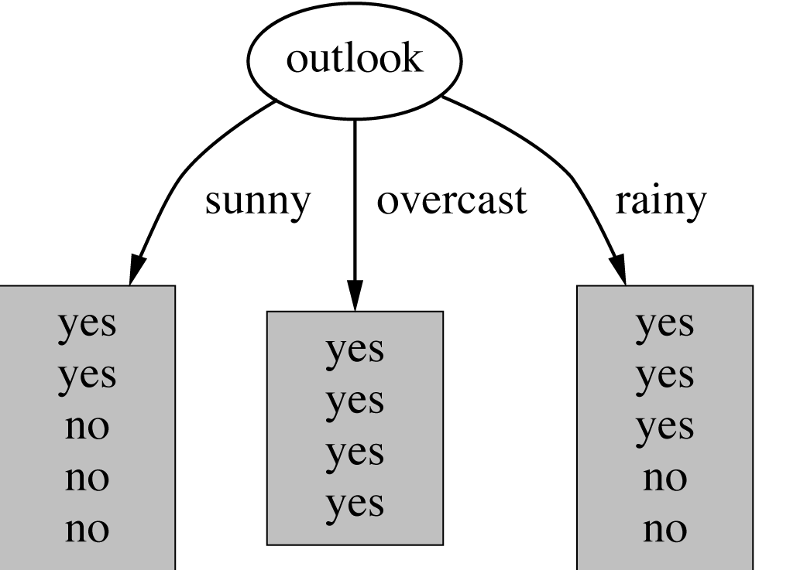
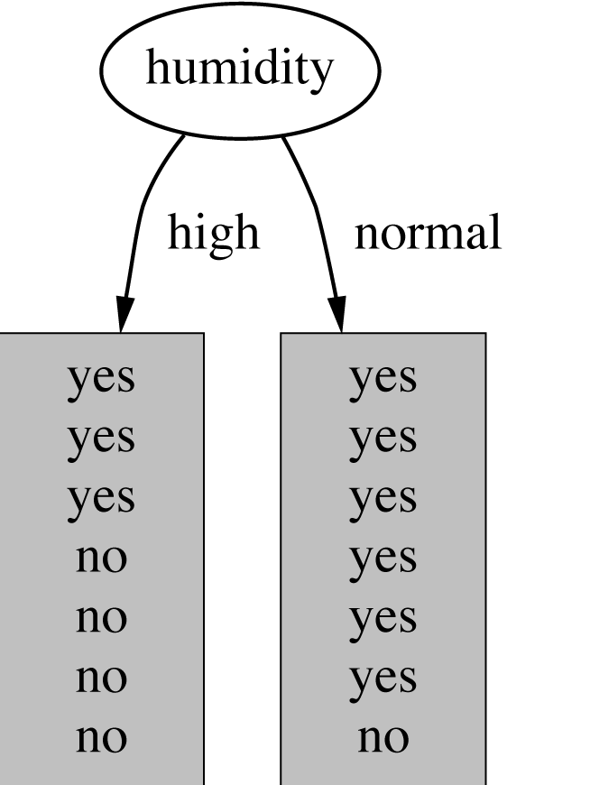
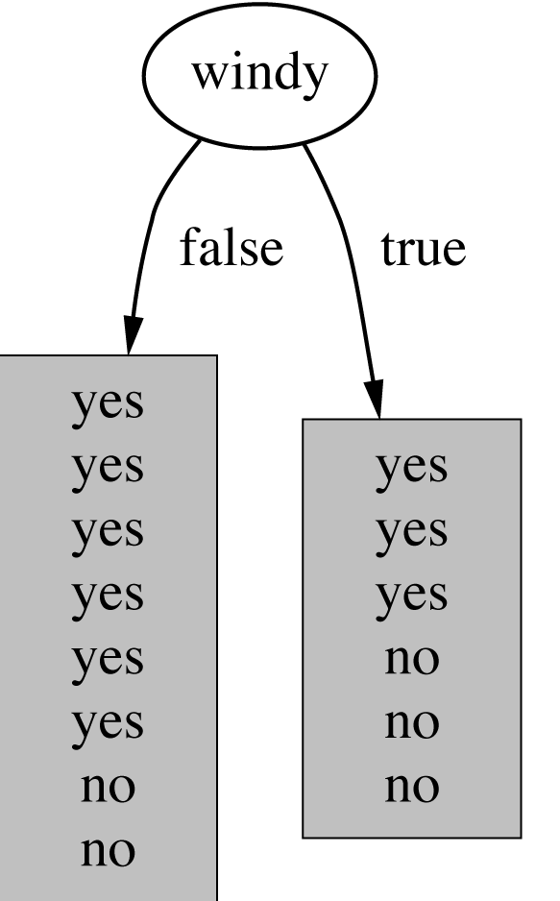
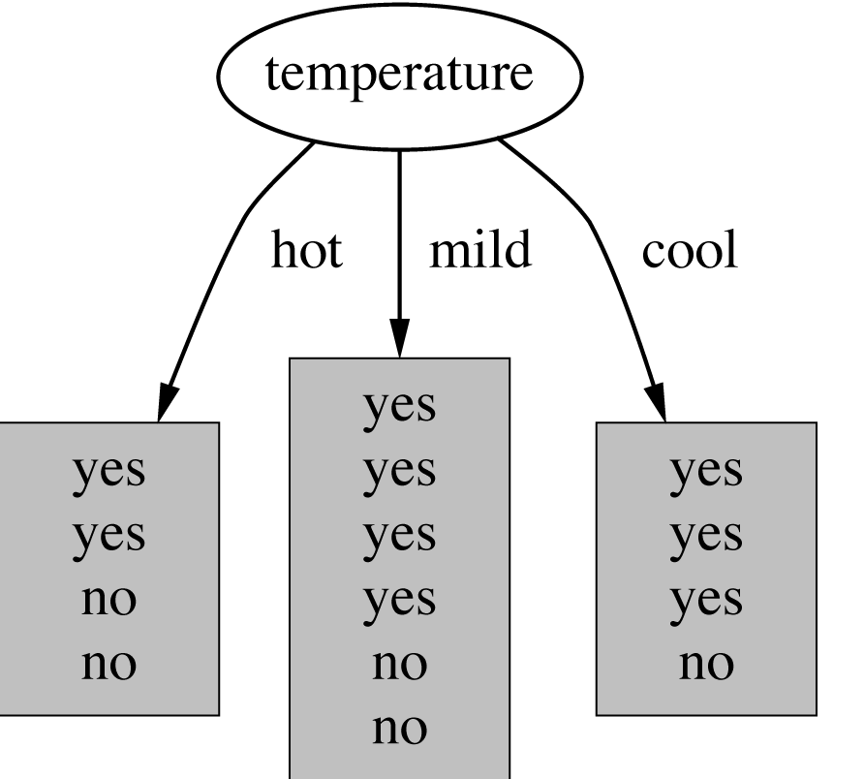
Which attribute to select?

Slide 6
A criterion for attribute selection
Which is the best attribute?
The one which will result in the smallest tree
Heuristic: choose the attribute that produces the “purest” nodes
Popular impurity criterion: information gain
Information gain increases with the average purity of the subsets that an attribute produces
Strategy: choose attribute that results in greatest information gain

Slide 7
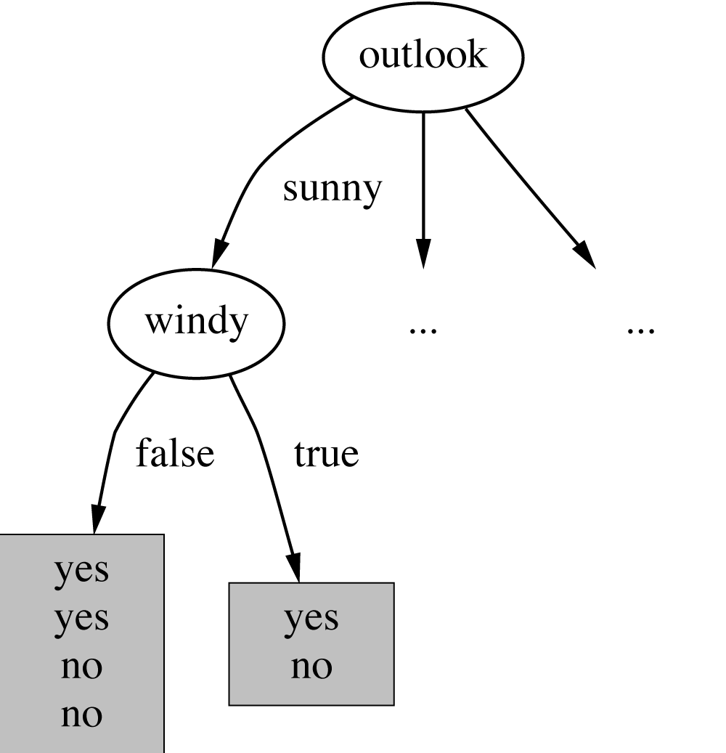
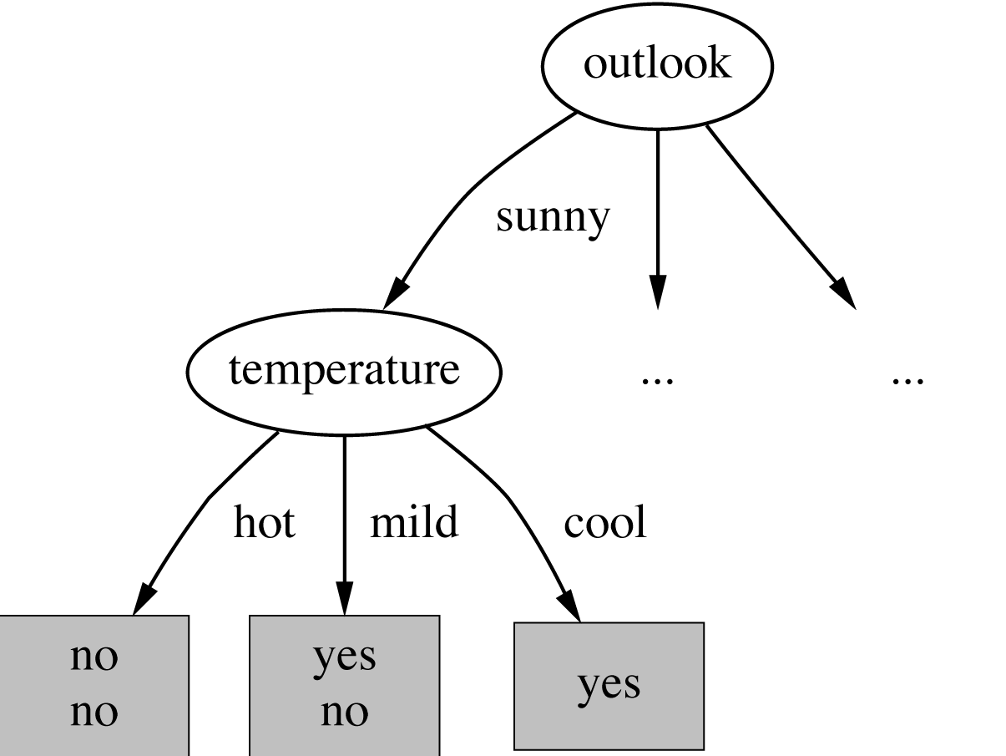
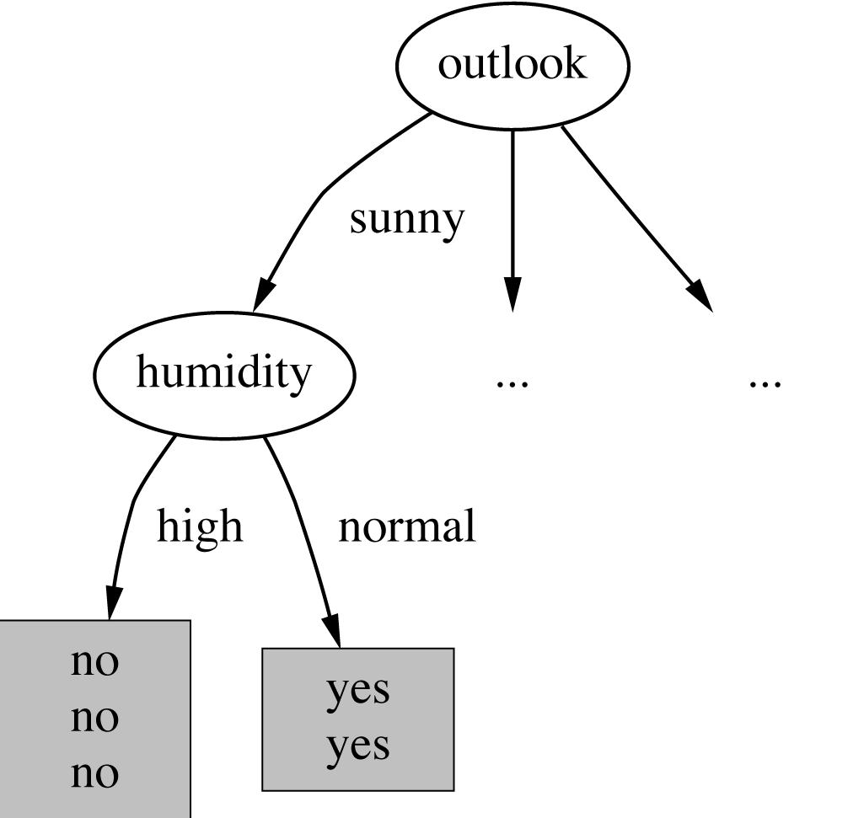
Continuing to split

Slide 8
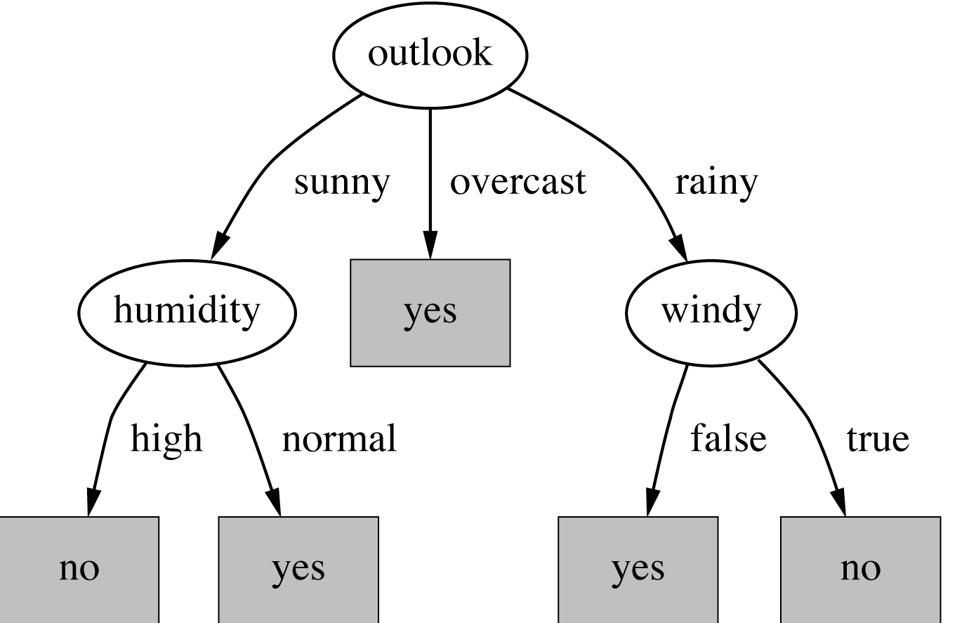
The final decision tree
Note: not all leaves need to be pure; sometimes identical instances have different classes
⇒ Splitting stops when data can’t be split any further

Slide 9
Highly-branching attributes
Problematic: attributes with a large number of values (extreme case: ID code)
Subsets are more likely to be pure if there is a large number of values
Information gain is biased towards choosing attributes with a large number of values
This may result in overfitting (selection of an attribute that is non-optimal for prediction)

Slide 10
Weather Data with ID code
ID | Outlook | Temperature | Humidity | Windy | Play?
A | sunny | hot | high | false | No
B | sunny | hot | high | true | No
C | overcast | hot | high | false | Yes
D | rain | mild | high | false | Yes
E | rain | cool | normal | false | Yes
F | rain | cool | normal | true | No
G | overcast | cool | normal | true | Yes
H | sunny | mild | high | False | No
I | sunny | cool | normal | False | Yes
J | rain | mild | normal | false | Yes
K | sunny | mild | normal | true | Yes
L | overcast | mild | high | true | Yes
M | overcast | hot | normal | false | Yes
N | rain | mild | high | true | No

Slide 11
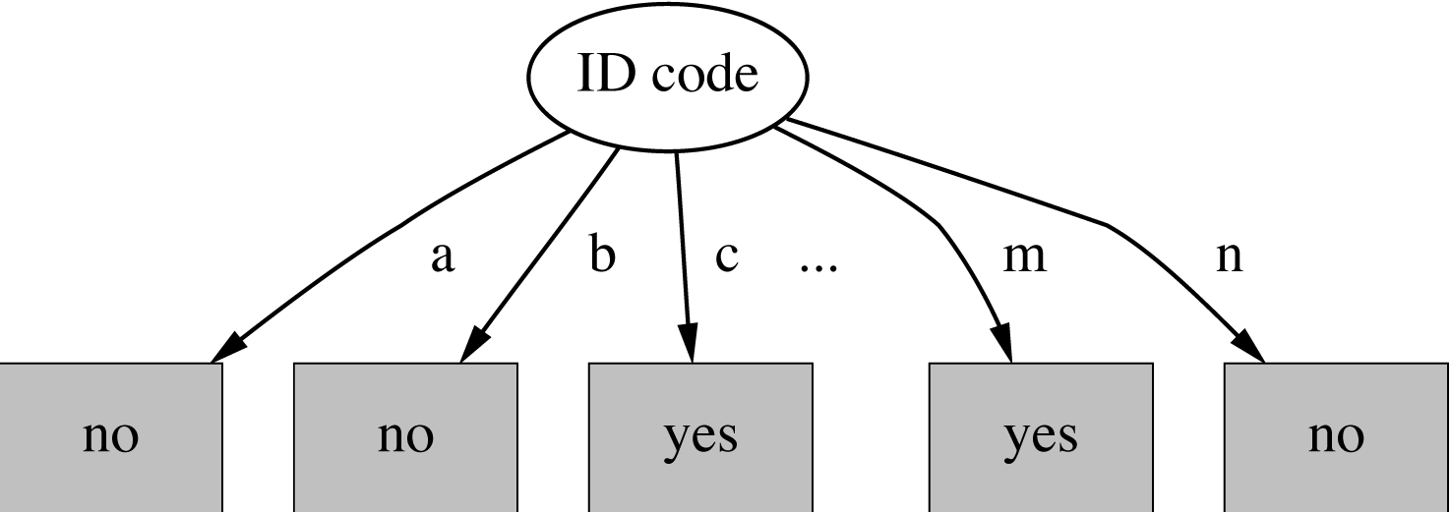
Split for ID Code Attribute

Slide 12
Gain ratio
Gain ratio: a modification of the information gain that reduces its bias on high-branch attributes
Gain ratio should be
Large when data is evenly spread
Small when all data belong to one branch
Gain ratio takes number and size of branches into account when choosing an attribute
It corrects the information gain by taking the intrinsic information of a split into account (i.e. how much info do we need to tell which branch an instance belongs to)

Slide 13
Gain ratios for weather data
Outlook |  | Temperature
Info: | 0.693 | Info: | 0.911
Gain: 0.940-0.693 | 0.247 | Gain: 0.940-0.911 | 0.029
Split info: info([5,4,5]) | 1.577 | Split info: info([4,6,4]) | 1.362
Gain ratio: 0.247/1.577 | 0.156 | Gain ratio: 0.029/1.362 | 0.021
Humidity |  | Windy
Info: | 0.788 | Info: | 0.892
Gain: 0.940-0.788 | 0.152 | Gain: 0.940-0.892 | 0.048
Split info: info([7,7]) | 1.000 | Split info: info([8,6]) | 0.985
Gain ratio: 0.152/1 | 0.152 | Gain ratio: 0.048/0.985 | 0.049

Slide 14
Gini index
If a data set D contains examples from n classes, gini index, gini(D) is defined as
p_{i} be the probability that an arbitrary tuple in D belongs to class C_{i}, estimated by
p_{i} = |C_{i, D}|/|D|

Slide 15
Gini index
The Gini index considers a binary split for each attribute.
Suppose an attribute A having v distinct values , {a₁, a₂, … , a_{v}}
we examine all of the possible subsets
Each subset, S_{A}, can be considered as a binary test for attribute A of the form “A ∈ S_{A}?”

Slide 16
Gini index
If a data set D is split on A into two subsets D₁ and D₂, the gini index gini(D) is defined as
Reduction in Impurity:
The attribute provides the smallest gini_{split}(D) (or the largest reduction in impurity) is chosen to split the node

Slide 17
Gini index
Home | Married | Gender | Employed | Credit rating | Risk
Yes | Yes | M | Yes | A | B
No | No | F | Yes | B | A
Yes | Yes | F | Yes | B | C
Yes | No | M | No | B | B
No | Yes | F | Yes | B | C
No | No | F | Yes | B | A
No | No | M | No | B | B
Yes | No | F | Yes | A | A
No | Yes | F | Yes | A | C
Yes | Yes | F | Yes | A | C
10 tuples
3 classes
A=3
B=3
C=4

Slide 18
Consider Home
Home | Married | Gender | Employed | Credit rating | Risk
Yes | Yes | M | Yes | A | B
No | No | F | Yes | B | A
Yes | Yes | F | Yes | B | C
Yes | No | M | No | B | B
No | Yes | F | Yes | B | C
No | No | F | Yes | B | A
No | No | M | No | B | B
Yes | No | F | Yes | A | A
No | Yes | F | Yes | A | C
Yes | Yes | F | Yes | A | C
2 subset
Yes(5), No(5)
 | Home type
Class | Yes | No
A | 1 | 2
B | 2 | 1
C | 2 | 2

Slide 19
Consider Home
2 subset
Yes, No
 | Home type
Class | Yes | No
A | 1 | 2
B | 2 | 1
C | 2 | 2

Slide 20
Consider Married
Home | Married | Gender | Employed | Credit rating | Risk
Yes | Yes | M | Yes | A | B
No | No | F | Yes | B | A
Yes | Yes | F | Yes | B | C
Yes | No | M | No | B | B
No | Yes | F | Yes | B | C
No | No | F | Yes | B | A
No | No | M | No | B | B
Yes | No | F | Yes | A | A
No | Yes | F | Yes | A | C
Yes | Yes | F | Yes | A | C
2 subset
Yes(5), No(5)
 | Marriage type
Class | Yes | No
A | 0 | 3
B | 1 | 2
C | 4 | 0

Slide 21
Consider Married
2 subset
Yes(5), No(5)
 | Marriage type
Class | Yes | No
A | 0 | 3
B | 1 | 2
C | 4 | 0

Slide 22
Consider Gender
Home | Married | Gender | Employed | Credit rating | Risk
Yes | Yes | M | Yes | A | B
No | No | F | Yes | B | A
Yes | Yes | F | Yes | B | C
Yes | No | M | No | B | B
No | Yes | F | Yes | B | C
No | No | F | Yes | B | A
No | No | M | No | B | B
Yes | No | F | Yes | A | A
No | Yes | F | Yes | A | C
Yes | Yes | F | Yes | A | C
2 subset
Yes(3), No(7)
 | Marriage type
Class | Male | No
A | 0 | 3
B | 3 | 0
C | 0 | 4

Slide 23
Consider Gender
2 subset
Yes(3), No(7)
 | Marriage type
Class | Male | No
A | 0 | 3
B | 3 | 0
C | 0 | 4

Slide 24
Finally
Attribute | Gini(D) | Gini index | Δgini
Home | .66 | .64 | .02
Married | .66 | .40 | .26
Gender | .66 | .358 | .302
Employed | .66 | .475 | .185
Credit rating | .66 | .64 | .02
Gender will be the splitting attribute

Slide 25
Thank you

